Slide 1
Real talk about real cloud migrations
Matt Gordon

Slide 2


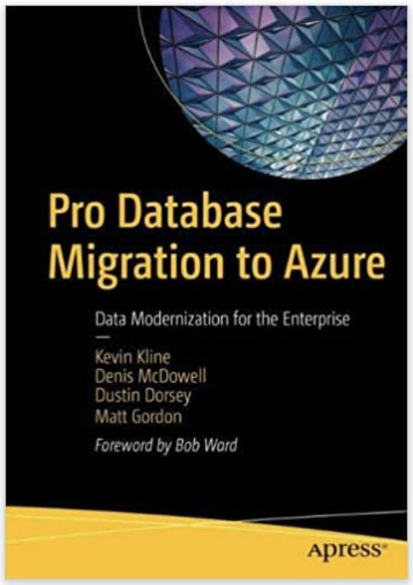
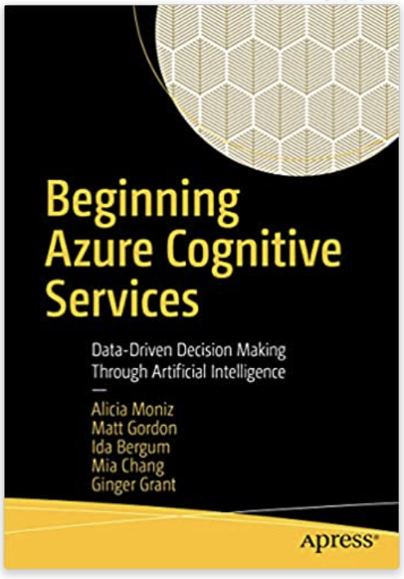
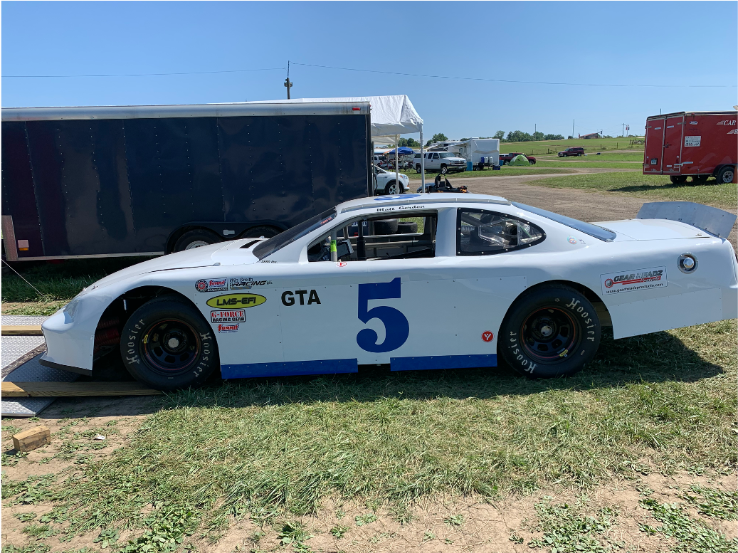
Matt Gordon
Senior Architect
matt@sqlatspeed.com
: @sqlatspeed
www.sqlatspeed.com

Slide 3


About me
20+ years of SQL Server experience
Microsoft Data Platform MVP
Friend of Redgate
Managed 24x7 datacenters
Leader of Lexington, KY Data Technology Group

Slide 4



somebody says move to the cloud…
Notes:
How is your migration starting (management-driven, consultant-driven, data team-driven, etc.)?

Slide 5
topics
What am I moving to the cloud?
When am I moving it to the cloud?
What am I using to move it to the cloud?
Where is it landing in the cloud?
Who do I need to move it to the cloud?
How are we paying for the move?
Notes:
Mention MS cloud adoption framework somewhere and include the link

Slide 6
What am I moving to the cloud?
Data
Relational data
Data warehouse
Other types

Slide 7
What am I moving to the cloud?
apps
Cots
homegrown
Architecture needs to be known?
Notes:
Are there web, app, middleware servers, etc.?

Slide 8
What am I moving to the cloud?
Data
Relational data
Data warehouse
Other types

Slide 9
What am I moving to the cloud?
Other stuff
servers
Network devices
Storage, vpn connections, etc.

Slide 10
When am I moving it to the cloud?
Understanding timeline is critical to success
What is driving the timeline?
WHAT is the penalty for missing the deadline?
Notes:
Is the penalty personal, team-wise, or corporate? (i.e. forced datacenter contract renewal, fees/penalties, etc.)

Slide 11
When am I moving it to the cloud?
Is there time to properly scope it?
Is there time for research?
Will there be a test environment?
Will it be a phased or all-at-once approach?
Notes:
Rev story goes here

Slide 12
What am I using to move it to the cloud?
Other stuff
Do we still need it?
Are there azure “devices”/services that can replace it?
Does the “etc.” need its own project?
Azure migrate
Notes:
We’re working kinda backwards from the original list in the last section
Focus a lot on rethinking your approach to stuff and emphasizing that lift and shift is rarely the right thing to do
Last point is where detail for rev/VPN connection project goes…also try to get people to think of their own examples

Slide 13
What am I using to move it to the cloud?
apps
Is it already in azure and does that do what we need?
Is its supported/required hardware and os compatible with Azure virtual machine offerings
Can we migrate vs. reinstall/reconfigure?
Azure migrate
Notes:
Mention things like ERP systems, ticketing systems, etc. that may be offered as a managed service
Tell risk management story about hospital and critical care bed system stuck on old stuff
Mention H-R story about finding out there were things told to be in scope that we were not allowed to move

Slide 14
What am I using to move it to the cloud?
data
Can we reimagine our data estate?
Can we use paas data offerings?
Can we leverage blob storage for unstructured data?
Do we have unique performance needs?
Variety of migration options
Notes:
Are PaaS data services supported by all the applications (mention H-R story about legacy app not supporting AAD at the time)
Mention that PaaS can lag VMs in performance
Discuss Azure Migrate, DMS, LRS for Mis, log shipping/replication for SQL VMs, etc.

Slide 15
Where is it landing in the cloud?
Sql server on azure vm
Azure sql database
Azure sql database managed instance
Azure synapse analytics
Power bi
Notes:
Could be a session all its own
Kinda did this for apps and other stuff already so let’s focus on data
Bring up Azure SQL DB provisioning screen and walk-through service tiers…then on to 3rd bullet
ASA for data warehousing (maybe…current client doesn’t need it and ASA can surface all kinds of data)…don’t believe the sales folks always
PBI for reports or maybe even old SSAS stuff (flesh that out a bit)

Slide 16
Who do I need to move it to the cloud?
internal
Networking team
operations team
Security team
Development team?
Data team
Notes:
Hammer home the point about the need for really strong networking people
Dev team for homegrown apps…talk about that some
Note about how it’s like that some/all of these teams are also supporting normal operations…you’ll need to bulk up staff or properly set expectations to avoid burning out employees and losing them

Slide 17
Who do I need to move it to the cloud?
external
consultants
Datacenter cooperation on the way out
Resale/recycling firms
Supplementary operational support people?
Notes:
Tell DCAC story…point out that I’m not just saying this because I am a consultant
Remember that consultants have seen and done a lot and are especially helpful if your team is brand new to Azure
Resale/recycling if you’re removing everything
Last point – do not recommend using core staff exclusively for this due to burnout

Slide 18
Who do I need to move it to the cloud?
Third-party entities
Can we reimagine our data estate?
Can we use paas data offerings?
Can we leverage blob storage for unstructured data?
Do we have unique performance needs?
Variety of migration options
Notes:
Go back to rev/VPN story here

Slide 19
How are we paying for the move?
Internal department chargeback?
Azure csp
Azure hybrid benefit
Notes:
Mention cost center chargeback again here
Infra as a cost sink can be dangerous for those teams come budget time
CSP is cloud solution provider (note that there can discounts had here)
…transition to lower level than sub-wide here for AHB…

Slide 20
How are we paying for the move?
Cost control practices
Turn off what you don’t need
Limit deployment permissions
Follow best practices
Resource groups and tagging
Audit, audit, audit
Notes:
Put some good cost control blogs on resources slide!!!
Tell story about devs deploying resources for research and never turning them off
Tell my own cognitive services story and I’m an “expert”
TONS of best practice guides for individual services

Slide 21
resources
Optimize your azure costs (microsoft landing page)
8 Tools w/ Gregor Suttie
Cost Management Updates (Microsoft blog)
Identifying suitable Azure SQL SKUs
Notes:
Point out that community blog information is fairly light on this topic…great opportunity for blogging, speaking, etc. and would be well received

Slide 22
The slide where I shill for my books
Cognitive services book
Database migration book

Slide 23
Additional resources

Slide 24
THANKS FOR ATTENDING!
Matt Gordon
Senior Architect
matt@sqlatspeed.com
: @sqlatspeed
www.sqlatspeed.com
https://github.com/sqlatspeed/2022_presentations

